Slide 1
“Hurricanes generate the most expensive property damage, the most spectacular images, and get headlines.
We name them, debate them, study them, remember them for generations.
Heat waves are the most lethal form of extreme weather.
They are the silent and invisible killers of silent and invisible people.”
Klinenberg 2015 “Heat Wave”

Slide 2
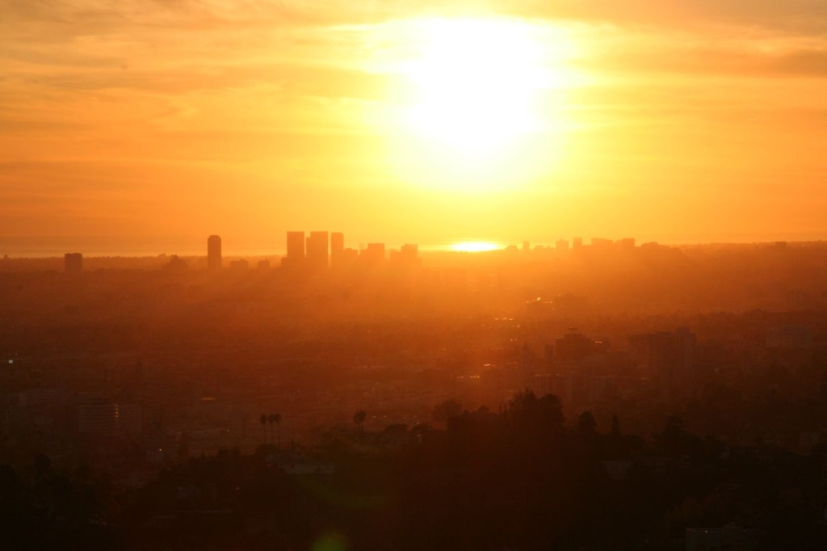
Turning up the heat on urban temperature data
T Loganª, S Guikemaª, K O’Meara^{b}, B Zaitchik^{c}
K Libermanª, C Zuoª, R Nicholsª
ª Industrial and Operations Engineering, University of Michigan ^{b} Architectural Design, Maryland Institute College of Art, Baltimore, Maryland
^{c} Johns Hopkins University, Baltimore, Maryland

Slide 3
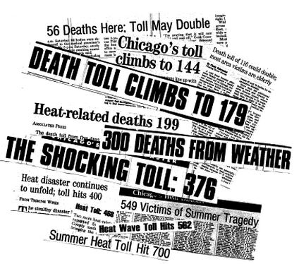
Urban Heat Island
Cities are becoming warmer
Trap heat
Exacerbate the severity of heat waves (Harlan, 2008)
Warmer weather -> increased risk
The 1995 Chicago inferno will be an annual event by 2080 with current climate trends (Peng, 2011)

Slide 4
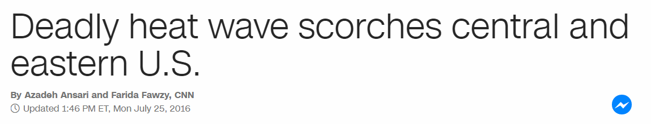
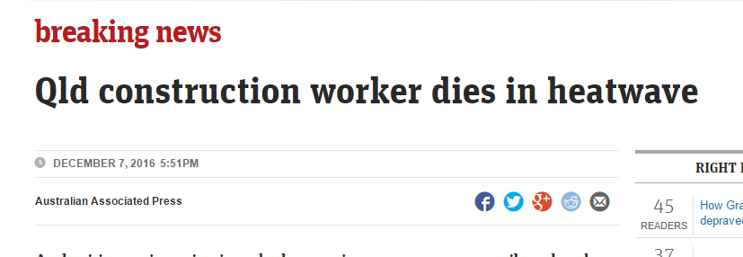
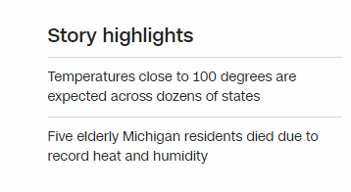
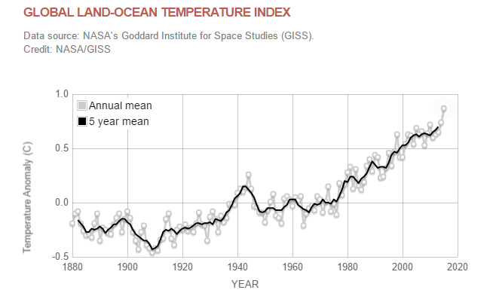
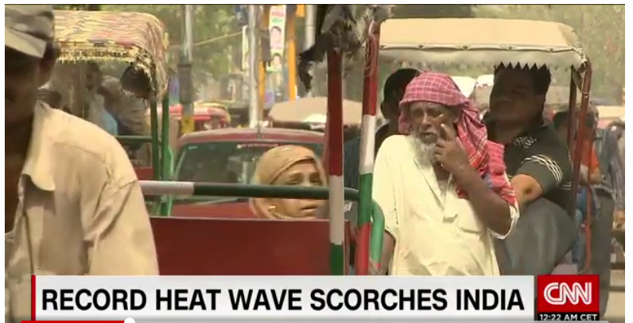

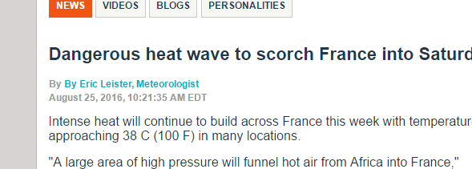
Risks of urban heat island

Slide 5
“Hurricanes generate the most expensive property damage, the most spectacular images, and get headlines.
We name them, debate them, study them, remember them for generations.
Heat waves are the most lethal form of extreme weather.
They are the silent and invisible killers of silent and invisible people.”
Klinenberg 2015 “Heat Wave”

Slide 6
Aim
Using data from five US cities:
Test fundamental hypothesis of land surface temperature and biophysical parameters
Explore relationships between land surface temperature and biophysical parameters
Predict land surface temperature using biophysical parameters

Slide 7
Why?
Confirm existing hypotheses
Test hypotheses’ applicability to range of cities
Predictive model so we can estimate the effect of changing the built environment on land surface temperatures

Slide 8
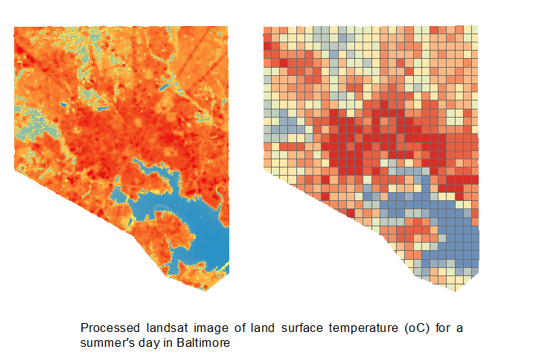
The data
Each city is gridded into squares of 37 hectares / 92 acres / (2000 ft)² / (610 m)²
Cities: Baltimore, Chicago, Detroit, Los Angeles, Portland
Four land satellite images averaged
For each grid cell the mean, max, and min is calculated
Variables:
Land surface temperature (normalized by city mean)
Impervious surface
Tree canopy
Elevation
Land cover
Vegetation index
Albedo

Slide 9
Land surface temperature in our cities

Slide 10
Land surface temperature in our cities

Slide 11
Land surface temperature and impervious surfaces
[linear model]
[Hierarchical model between cities to determine if coefficient is the same]
[mixed effects term in linear model significant?]

Slide 12
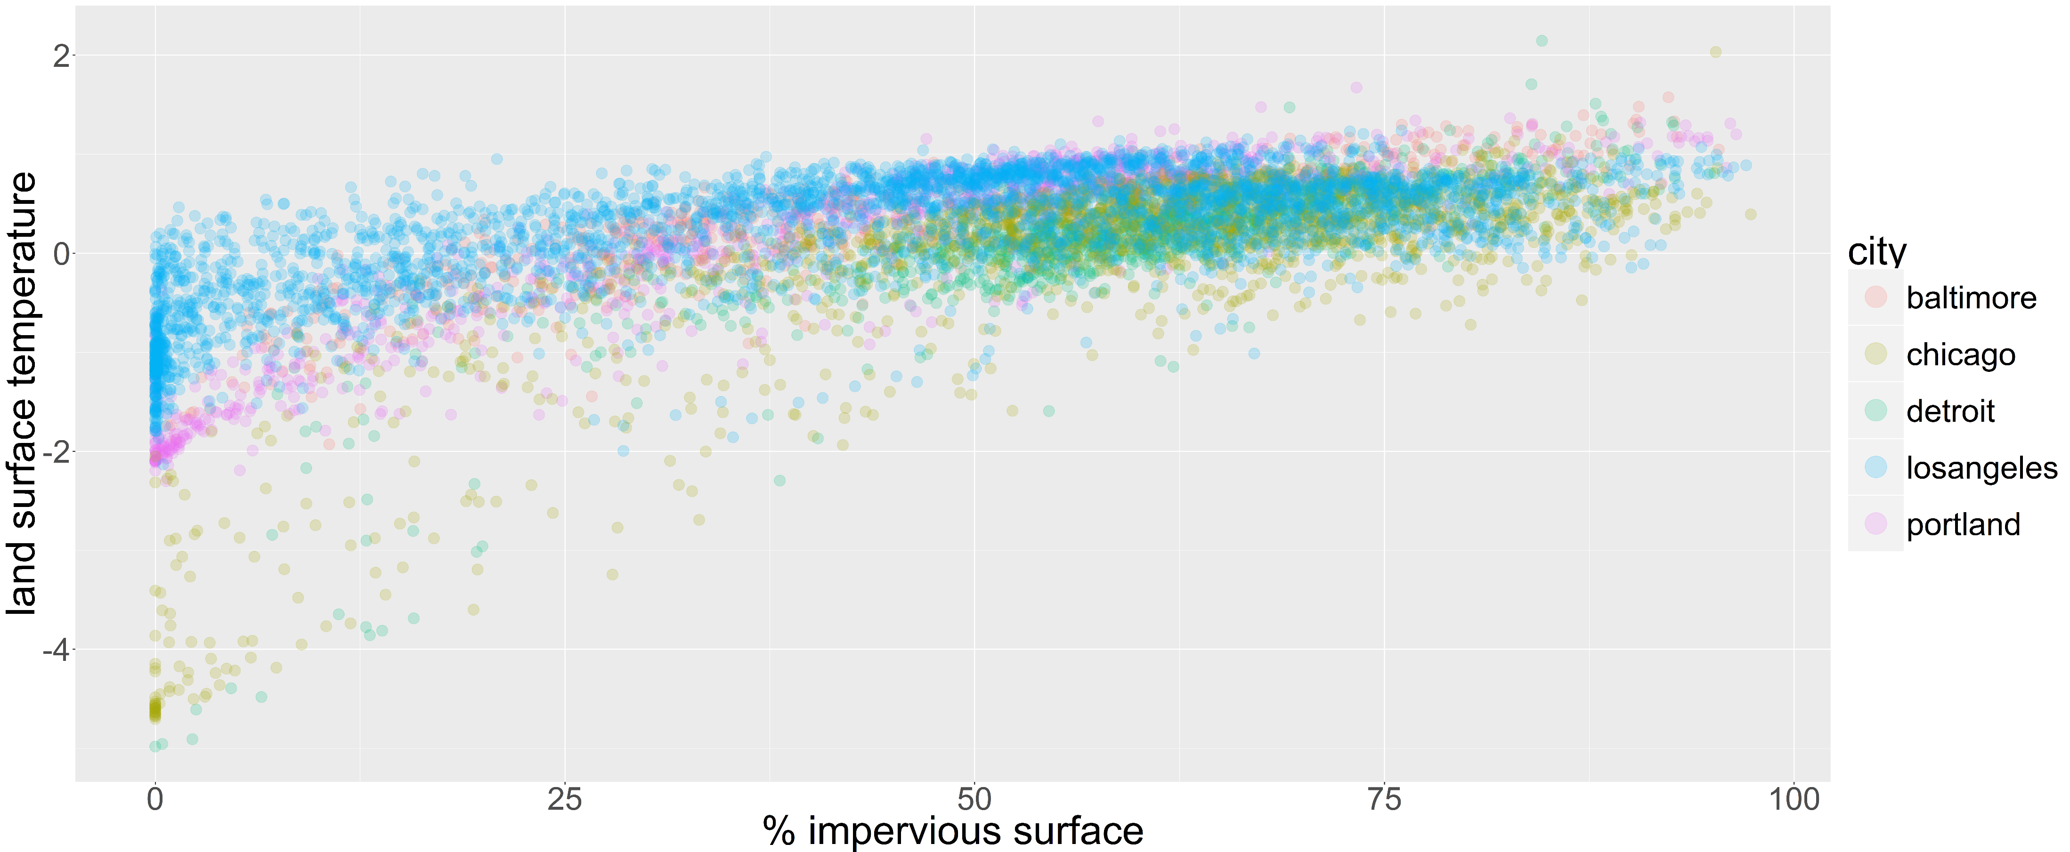
Is LST a function of impervious surfaces?
LST = land surface temperature

Slide 13
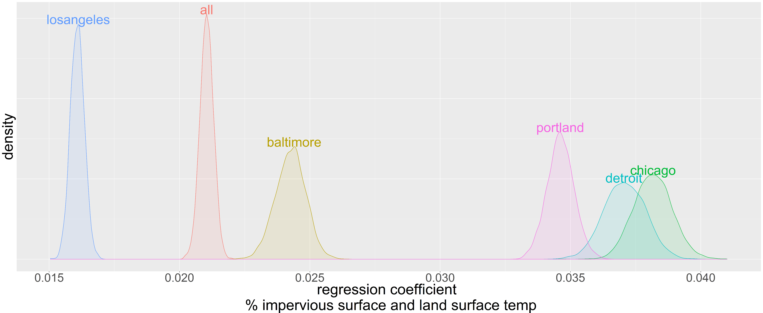
Is LST a function of impervious surfaces? Regression coefficient
LST = land surface temperature

Slide 14
Is LST a function of impervious surfaces? Remarks
Bayesian linear regression
Prior was a Cauchy distribution based on the distribution of the combined dataset (we expect the effect to be similar)
Reject that effect of impervious surfaces is the same between cities
Always positively correlated with land surface temperature

Slide 15
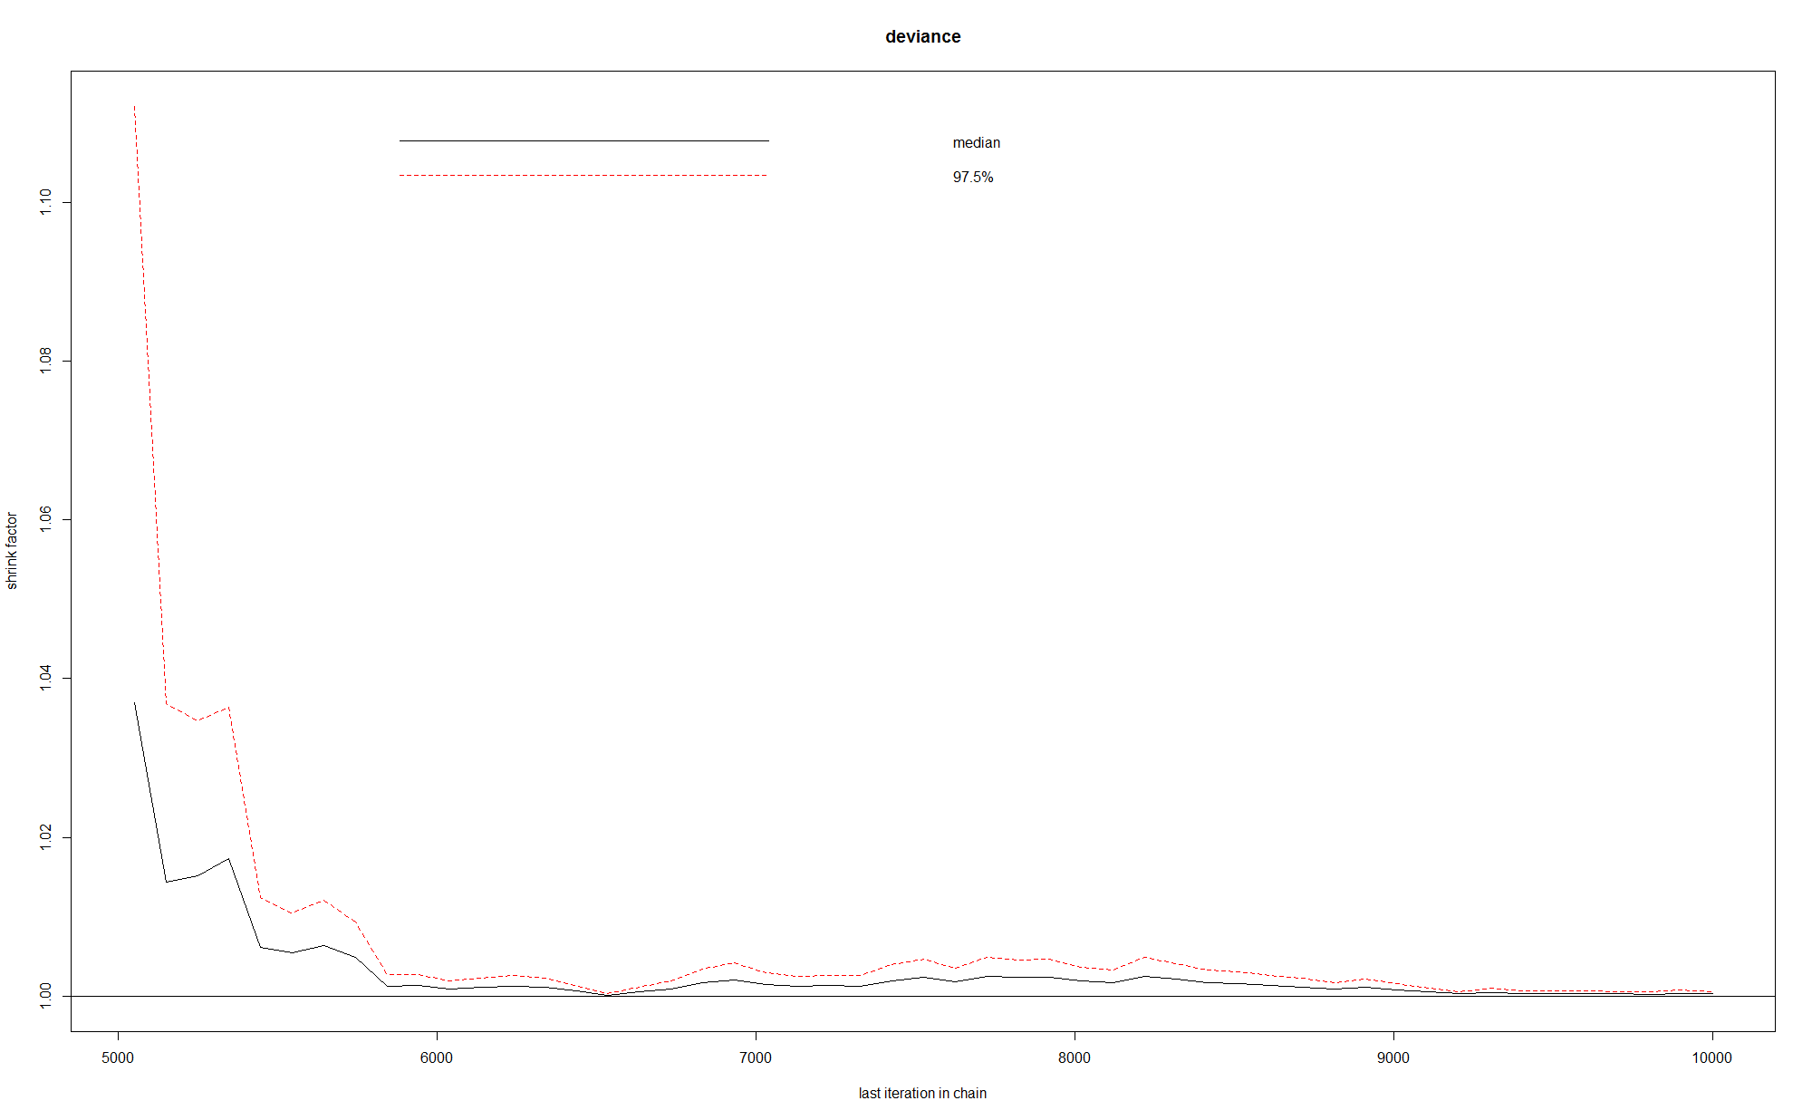
Bayesian formalities
Trace
Convergence

Slide 16
Are darker impervious surfaces hotter than impervious brighter surfaces?
[Cluster by imperviousness]
[look at distribution of albedo and LST for each cluster]
[model albedo and LST]
[look at the Bayes net for high impervious and high LST. What is albedo?]

Slide 17
Are darker impervious surfaces hotter than impervious brighter surfaces?
Albedo is a measure of “whiteness” of a surface
Are whiter surfaces (such as concrete) better for reducing land surface temperature than darker (e.g. asphalt)

Slide 18
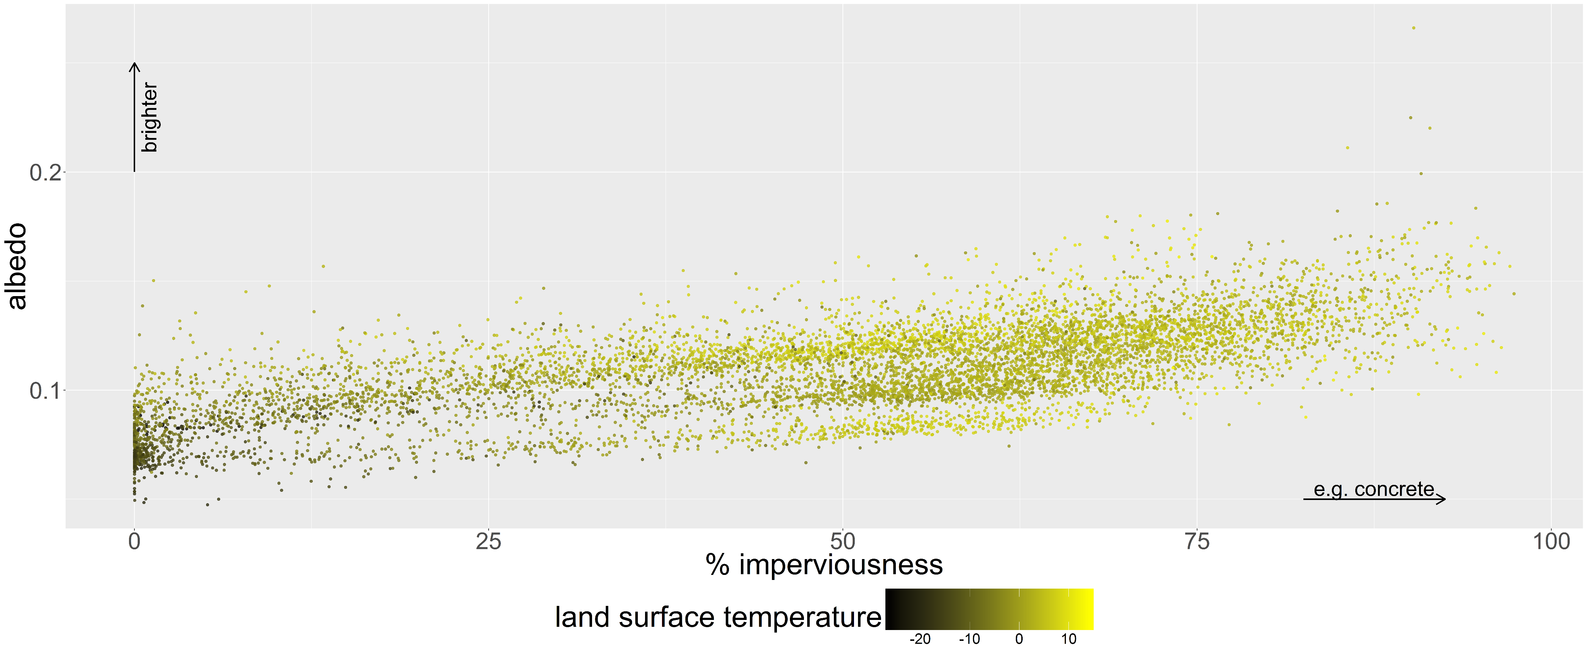
Are darker impervious surfaces hotter than impervious brighter surfaces?

Slide 19
Are darker impervious surfaces hotter than impervious brighter surfaces?
Cluster data by % imperviousness
Bayesian regression on the most impervious cluster

Slide 20
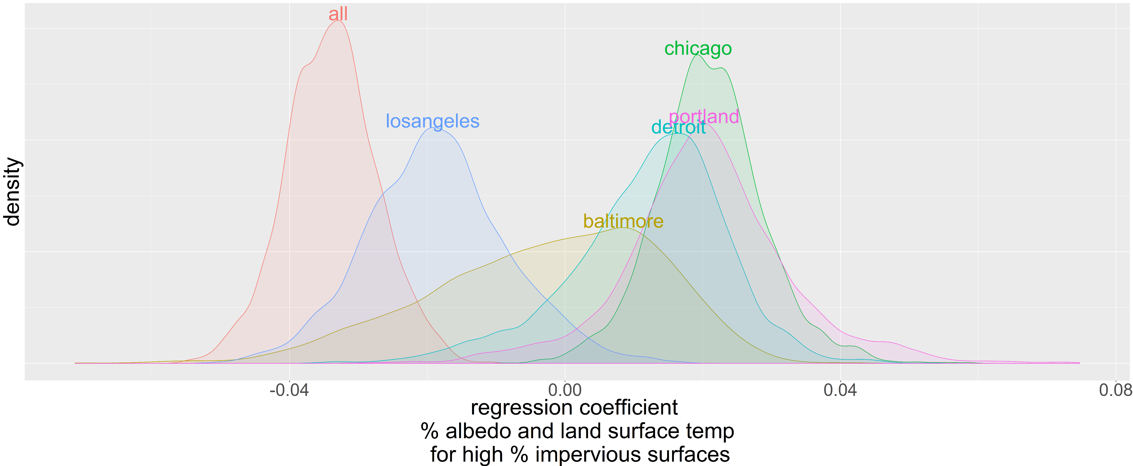
Are darker impervious surfaces hotter than impervious brighter surfaces?

Slide 21
Are darker impervious surfaces hotter than impervious brighter surfaces?
Maybe? (regression coefficient is not < 0 for all cities)
This indicates that as albedo increases, so does land surface temperature
Significant variation between the cities
This is a surprising result
Prior was negative (reflecting the “all city” evidence)
Sensitive to threshold of impervious %

Slide 22
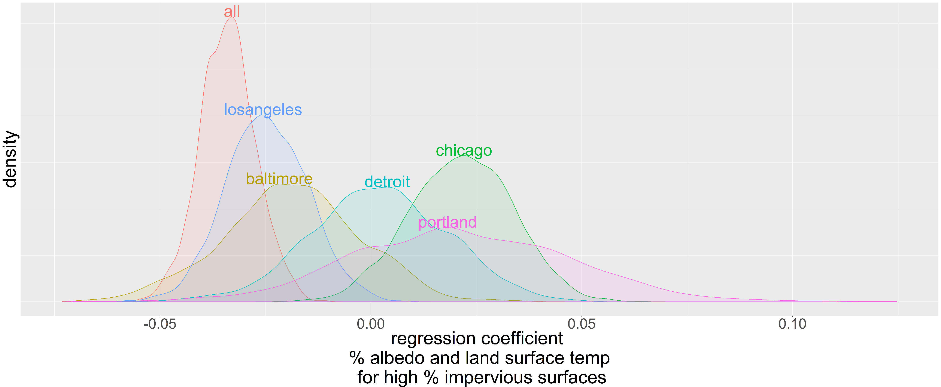
Are darker impervious surfaces hotter than impervious brighter surfaces? (weak prior)

Slide 23
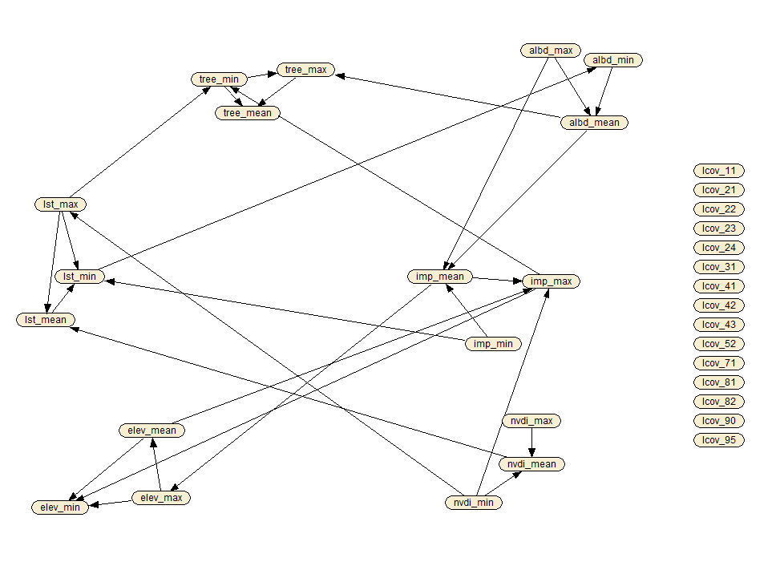
Exploring the data: Bayesian Network

Slide 24
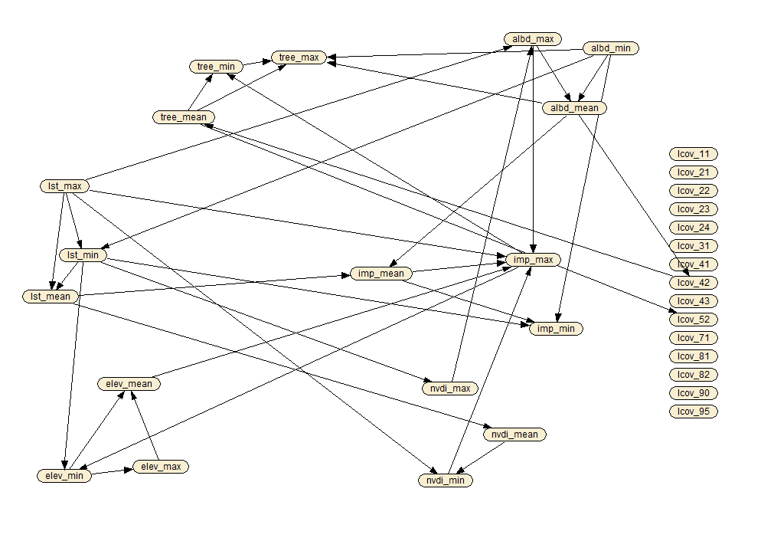
Networks are not city dependent
All cities (grow-shrink structure)
Chicago

Slide 25
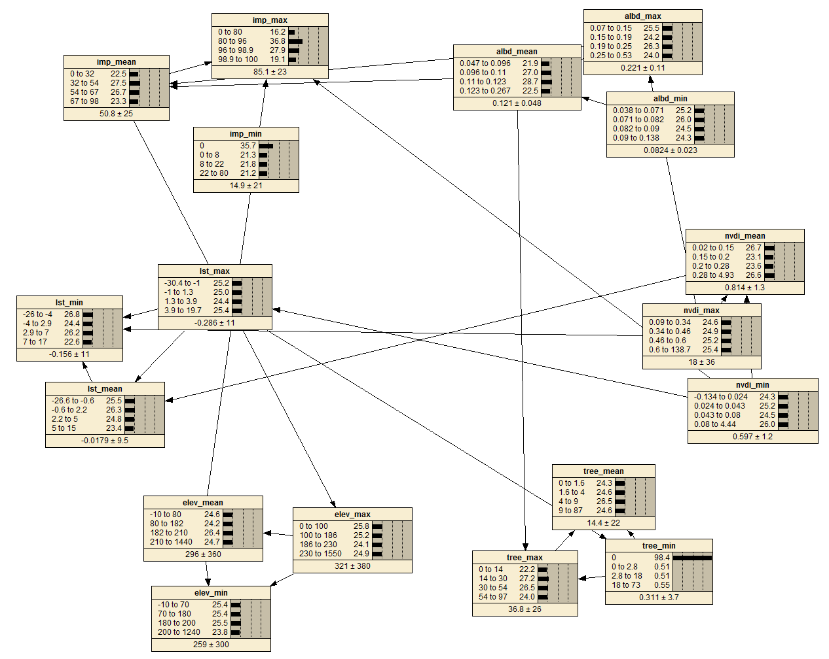
Bayesian Network (Expectation Maximisation Probabilities)

Slide 26
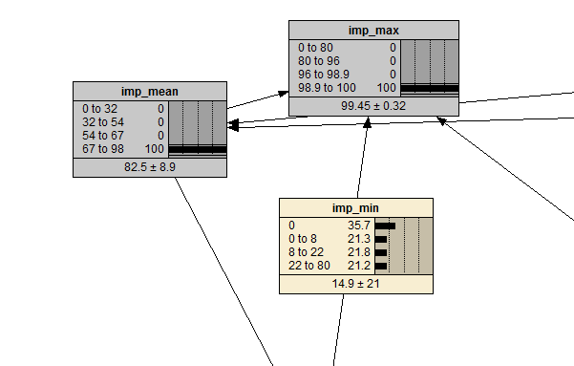
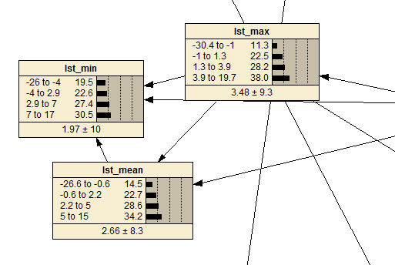
Bayes net land temperature and impervious surface
Impose impervious surface
Temperature likelihood skews hotter

Slide 27
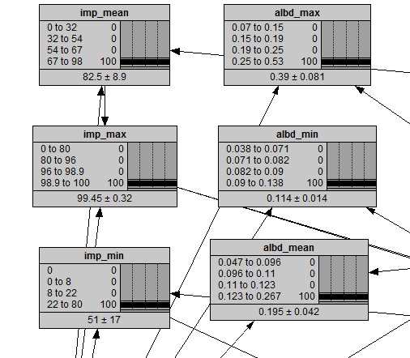
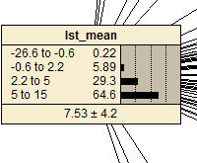
Bayes net land temperature and impervious surface
Impose impervious surface and albedo
Temperature likelihood skews hotter

Slide 28
Predicting land surface temperature
Attempt to predict the land surface temperature using biophysical parameters
Compare Bayesian Additive Regression Trees (BART) against other models
BART
Tree based model e.g. categorises response based on inputs
Each tree has a noninformative prior
Fitting is based on MCMC, which generates samples from posterior
Can be used for probabilistic forecasts

Slide 29

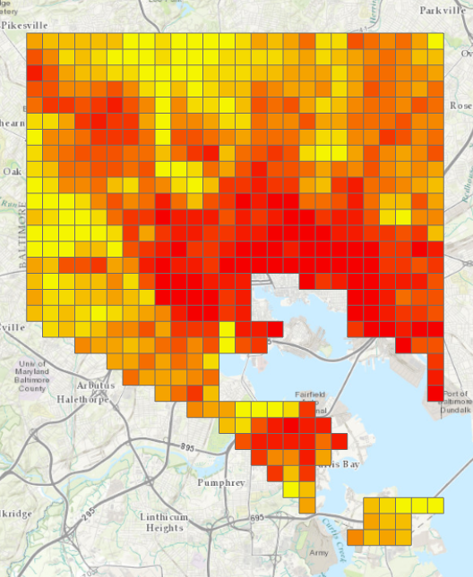
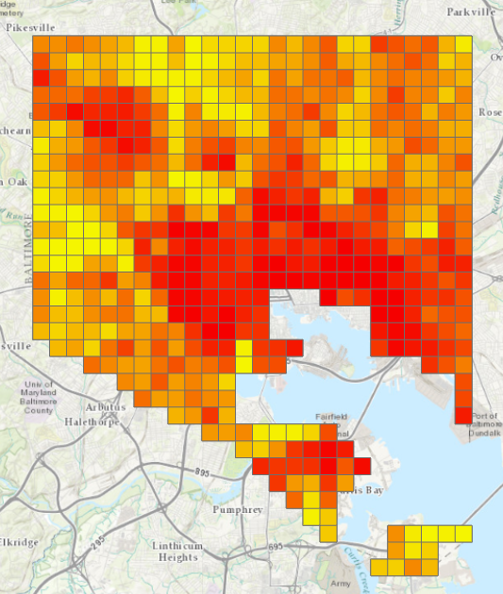

Predicting Baltimore’s surface temperature (spatially independent)
Actual land surface temperature
BART predicted land surface temperature

Slide 30
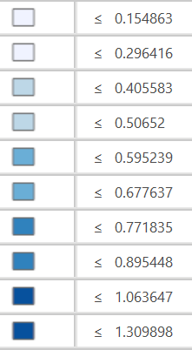
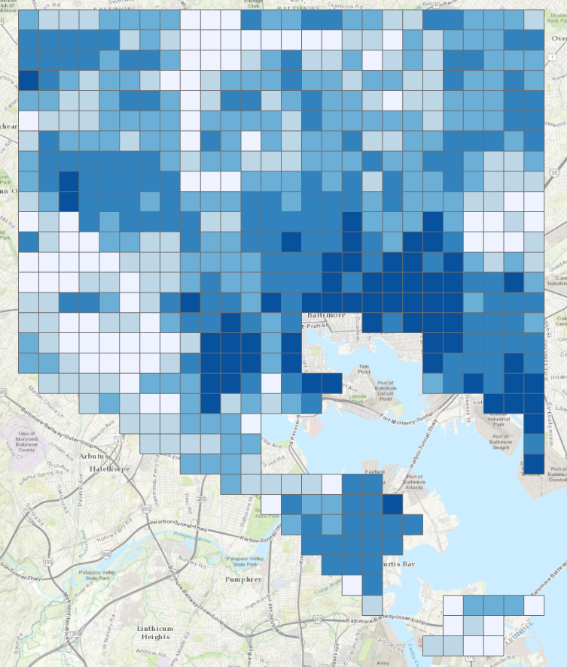
Predicting Baltimore’s surface temperature: spatially independent, actual - predicted

Slide 31
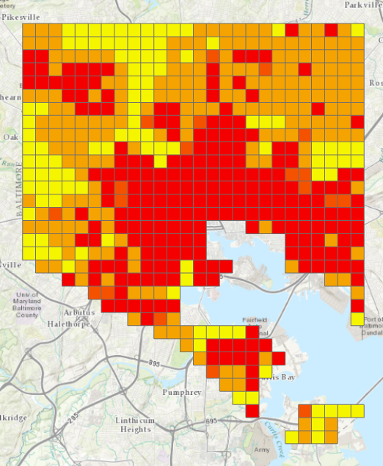

Predicting Baltimore’s surface temperature (spatially independent)
Actual land surface temperature
CART predicted land surface temperature

Slide 32
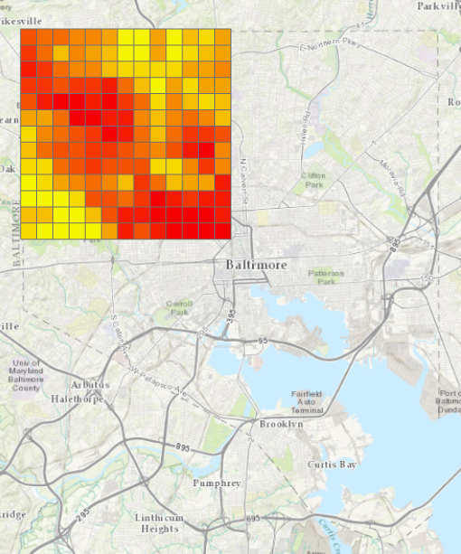

Predicting the northwest corner of Baltimore (spatially dependent)
Actual
BART prediction

Slide 33
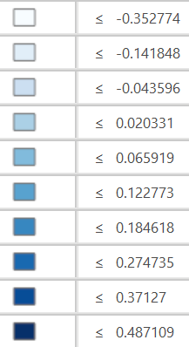
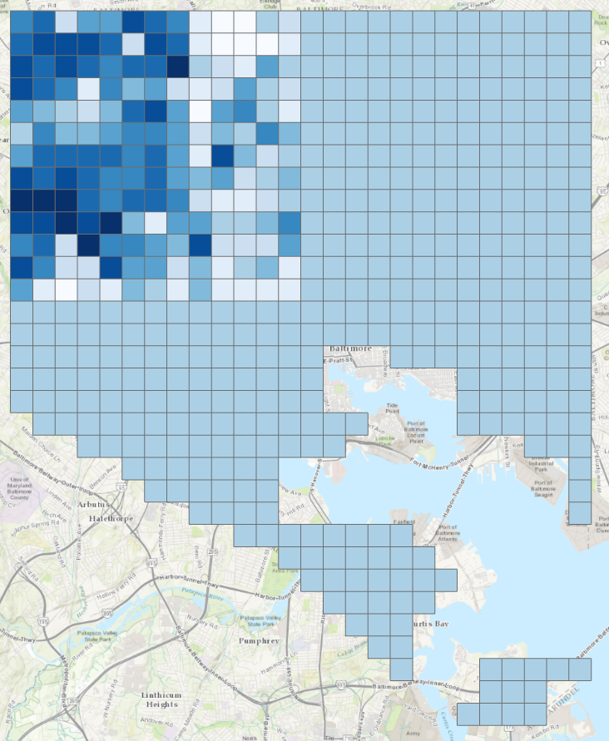
Predicting the northwest corner of Baltimore: spatially dependent, actual - predicted

Slide 34
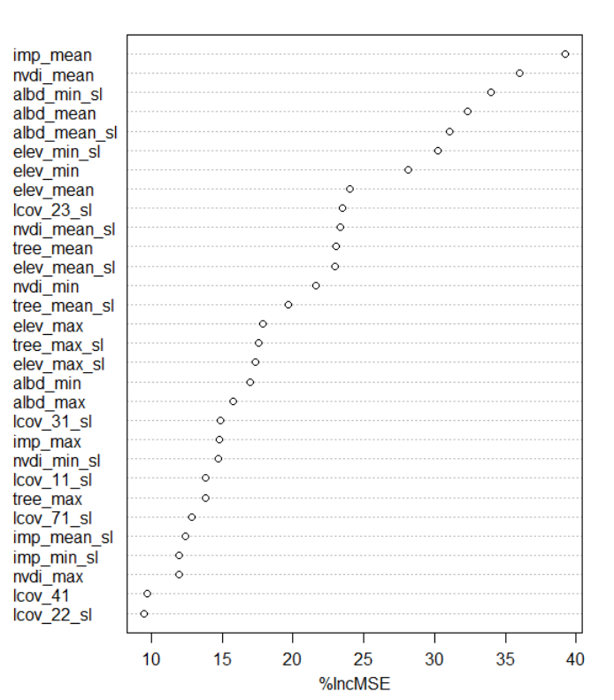
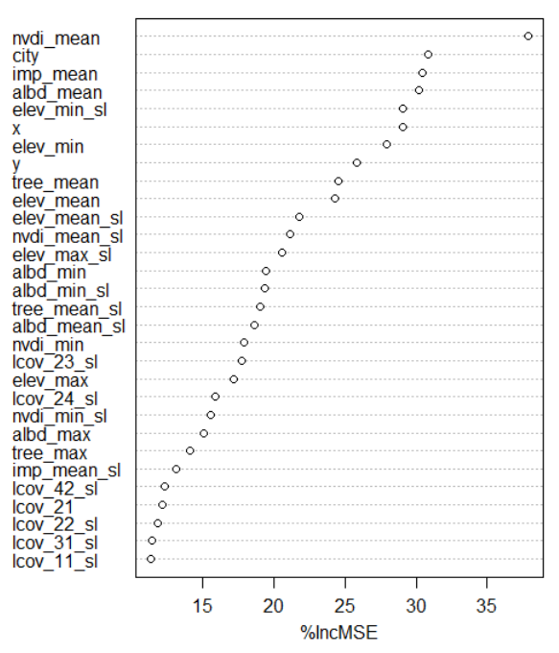
Predicting surface temperature: Variable importance
Spatially independent
Spatially dependent

Slide 35
Predicting land surface temperature
[can we predict LST from biophysical factors]
[leave out city, predict city]
[leave out part of city]
[include local change in elevation]
[compare spatial model vs. non spatial model]
[probabilistic prediction of LST]
[variable importance]
[variable selection]

Slide 36
The park effect
[Probably just with Baltimore data for now]
[does a higher area of park in a cell decrease the LST?]
[does distance to nearest park, and park area in cell and surrounding cells decrease LST? Is it significant?]
[Is there a halo affect? Plot LST and distance to nearest park]
[Does the size of the nearest park matter?]

Slide 37
The shade of affluence
[Is LST correlated with property value?]
Harlan, Sharon L., et al. "In the shade of affluence: the inequitable distribution of the urban heat island." Research in social problems and public policy 15 (2007): 173-202.

Slide 38
Further steps?
Investigate the collinearity in data from land satellite images
Incorporate demographic data into the analysis to understand people’s vulnerability
Understand the importance of green space in the city
Probabilistic prediction and uncertainty

Slide 39
References
Harlan, Sharon L., et al. "In the shade of affluence: the inequitable distribution of the urban heat island." Research in social problems and public policy 15 (2007): 173-202.

Slide 40
Questions?
tomlogan.co.nz

